Slide 1
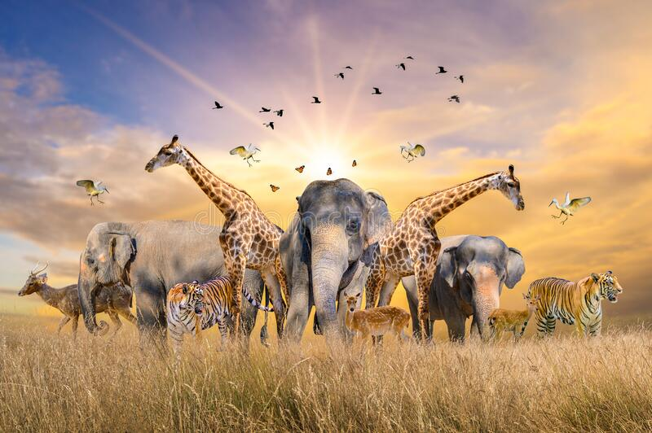
Mariné du Plessis
DV200

Slide 2
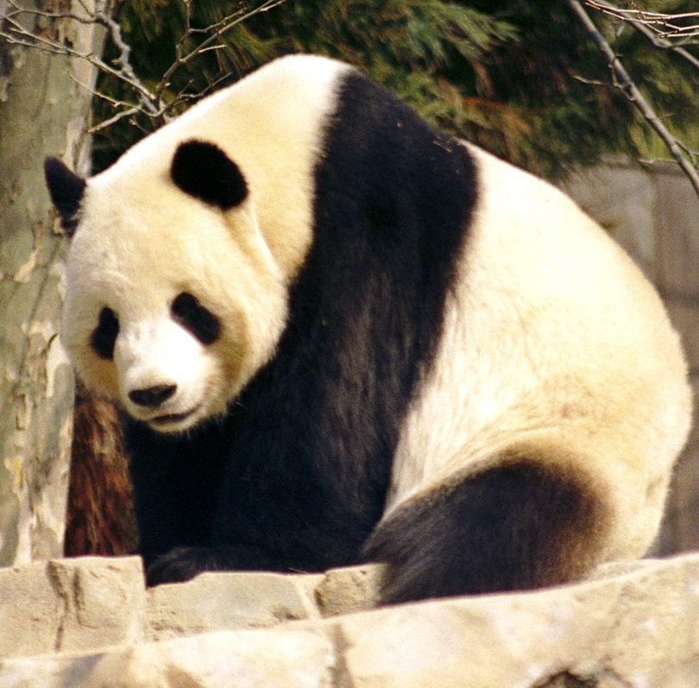
Brief
I took on the role of a data driven developer, being tasked with implementing a real-world data driven web application. I could use an API of my choice for the data that had to be collected. I needed to focus this term on research, analysis, implementation and visualization of the API of my choice. The project needed to use charts.js to display the data on different charts and it also needed to use React to create the framework of the front end of the website.

Slide 3
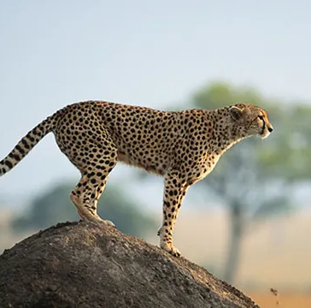
Development Process

Slide 4
Problem – Create a data driven web application
The following project specifications for the website was received:
Dashboard
Summarize or breakdown of a chosen dataset
Introduce and conceptualize a concept and do research
Add a unique UI element to this page
Comparison Page
Add 3 charts on this page and the three charts is Bar, Pie Radar/Polar Area
The user should be able to select another object to compare
Timeline Page
This page needed to contain a timeline chart
The timeline should display one property for 5 different objects
They must also be able to change the property via an input

Slide 5
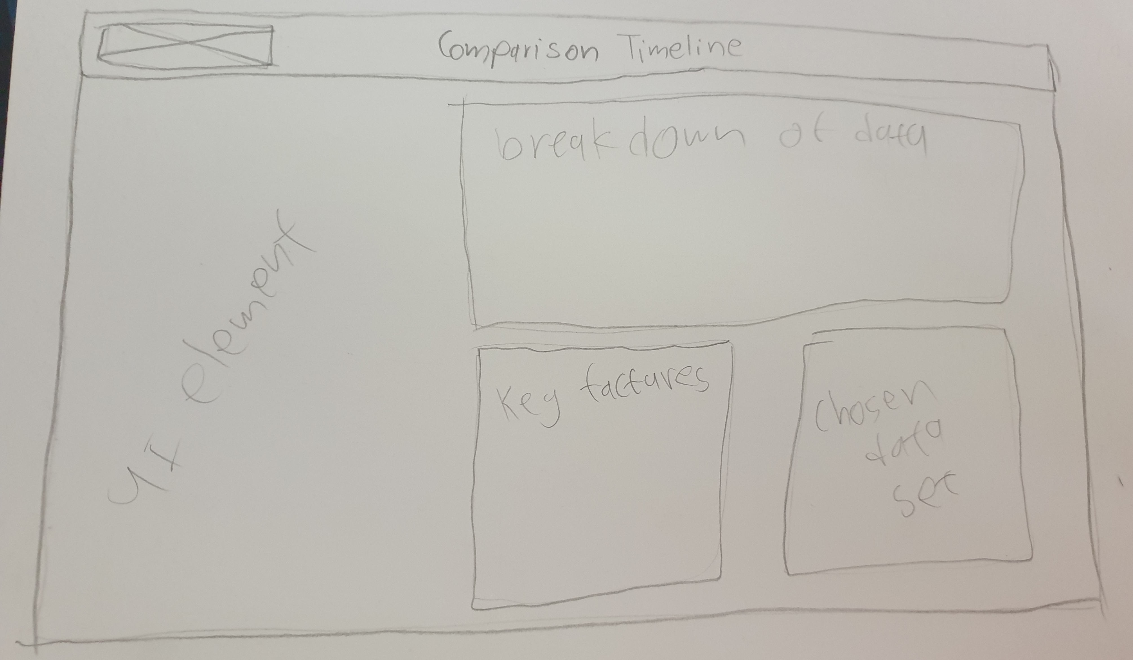

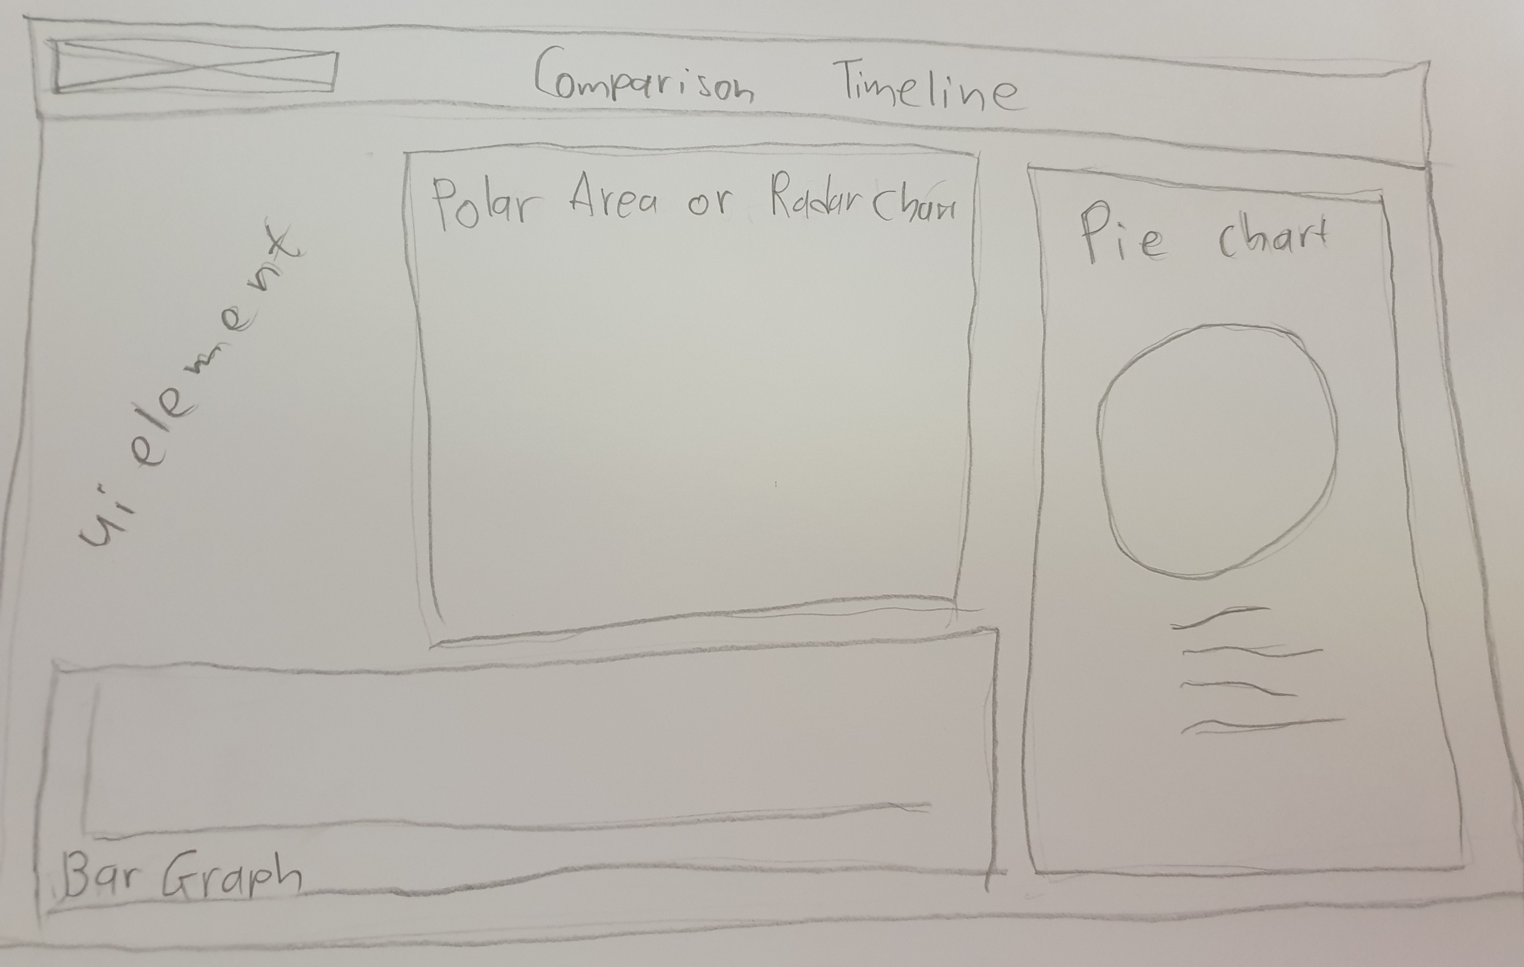
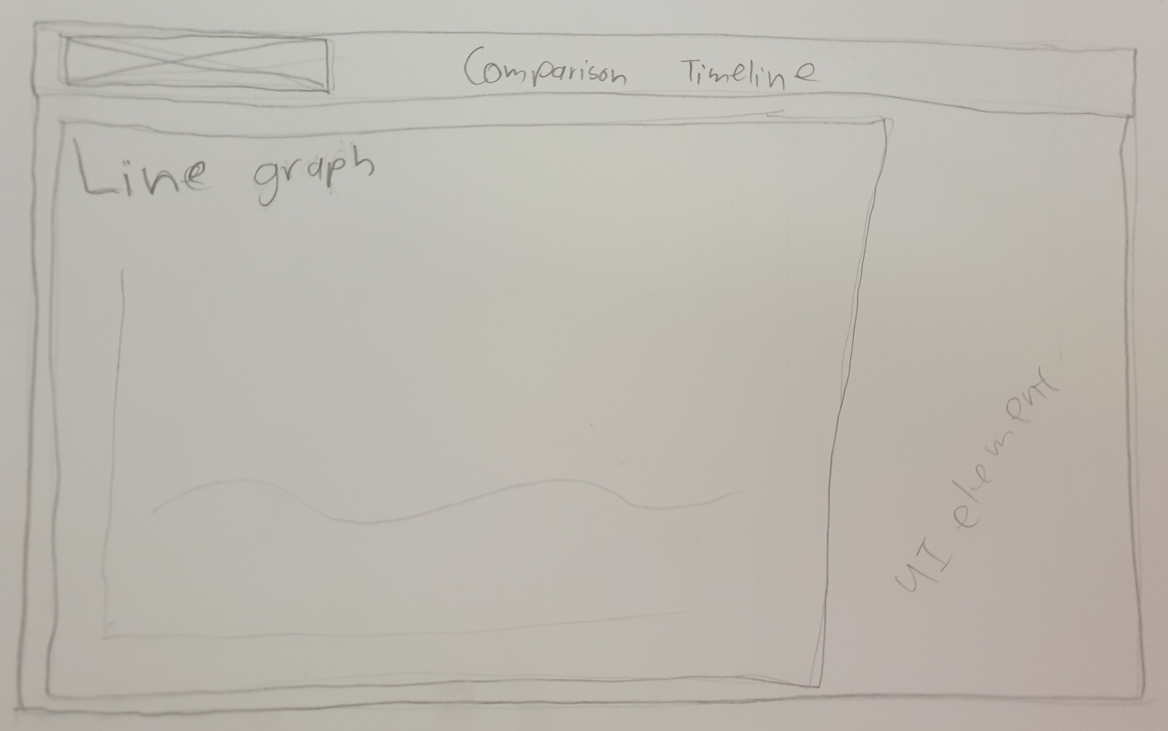
Design Frame
I had to design my own wireframes for the three website pages. I had to design two pages that needed to have a chart on it, the chart had to be readable with the information on it. I also created my own logo to fit with the dataset of my chosen API.

Slide 6

Technologies and/or frameworks used
The frameworks that I used was React, CSS, JS, Charts.js and GitHub.
I used Microsoft Visual Studio to develop the website in.
React was used to develop the front end of the website with their JavaScript library.
CSS was used for the inline styling as there was various style elements that had to be added.
JS was used for all the scripting of the functions, creating the dropdown box that displays animal names.
Chart.js was used to add different charts to the Compare and Timeline page.
GitHub was used to do version control for my website and to be the repository for my code.
React – Open-source front-end JavaScript library
CSS – Cascading Style Sheet
JS – JavaScript
Chart.js – Open source data visualisation framework
GitHub – Internet hosting service for software development and version control using GIT

Slide 7
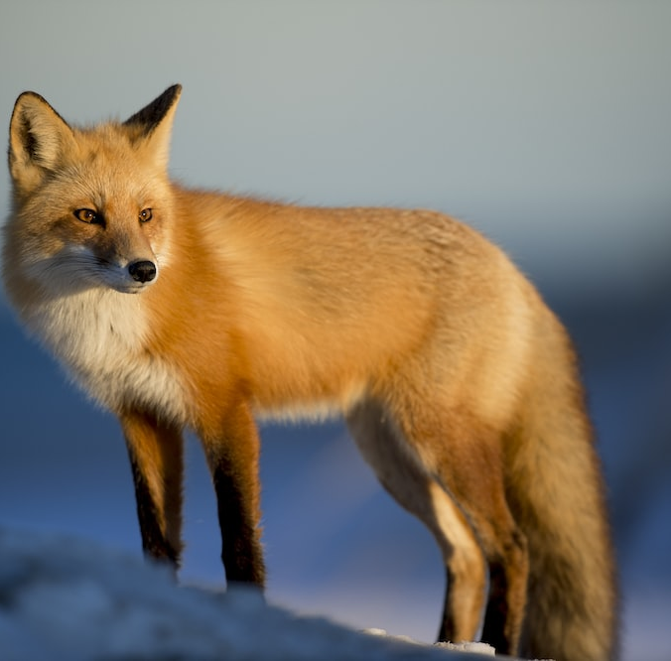
Planning and Documentation

Slide 8
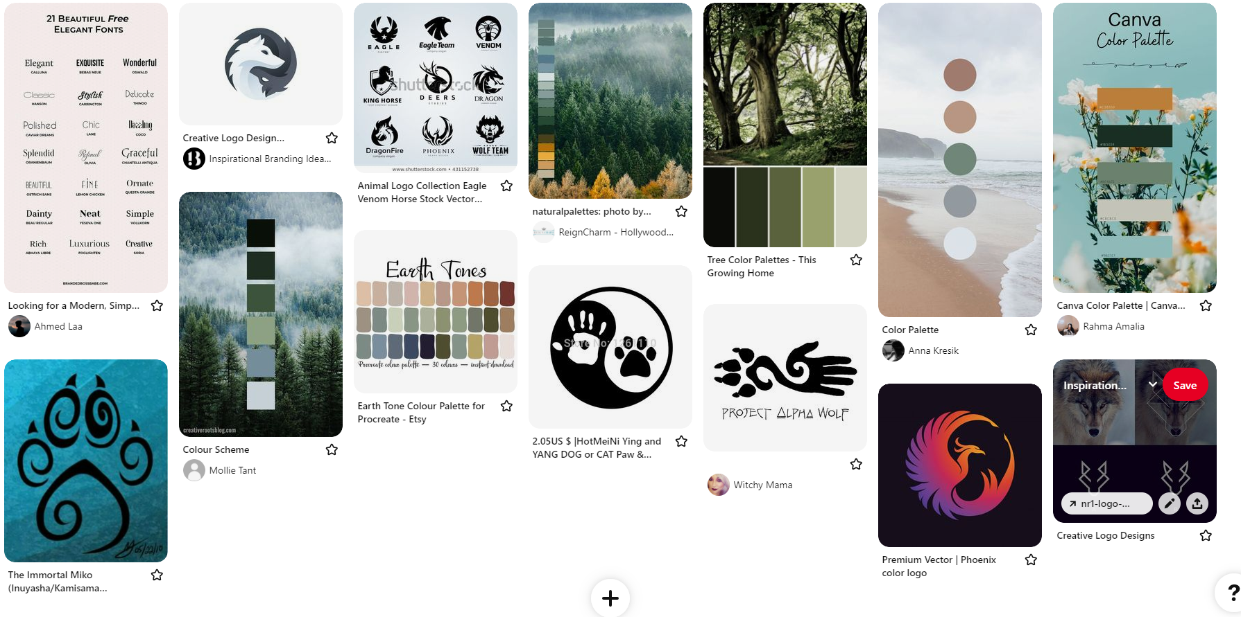
Visual Concept

Slide 9
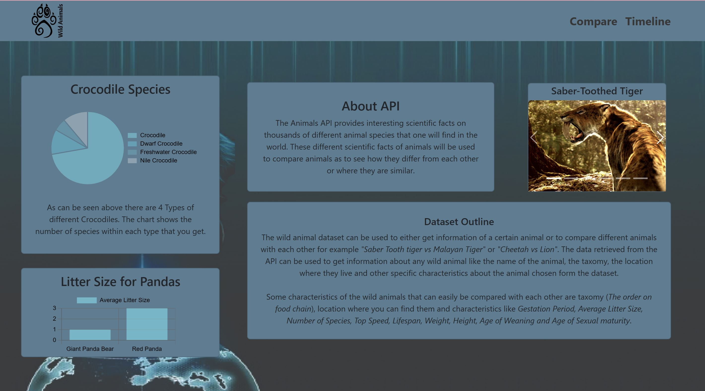
Feature and Functionality – Dashboard Page
The requirements for this page was that it needed to display a summary or breakdown of the chosen dataset and display information like key factors of the research or the chosen dataset. On the dashboard page the user can find more information about the website and the API that is used. On this page there is a carousel that displays a distinct animal visually with some interesting facts. There are also two charts on the page, one chart shows the average litter size of panda species and another chart that shows number of species for crocodiles.

Slide 10
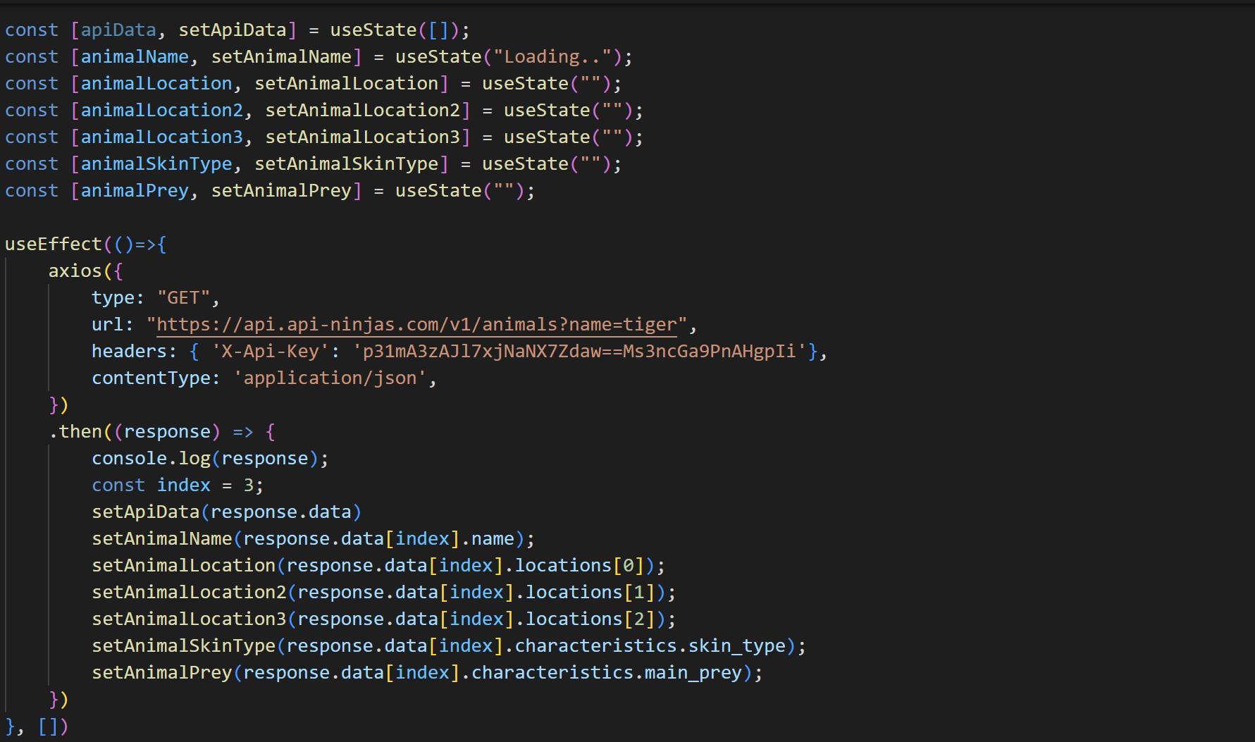
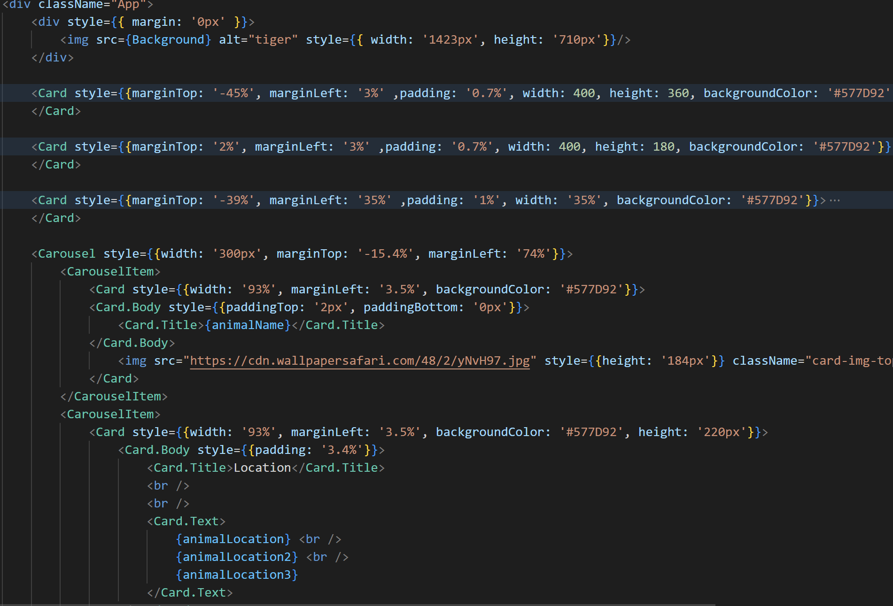

Code – Dashboard Page

Slide 11
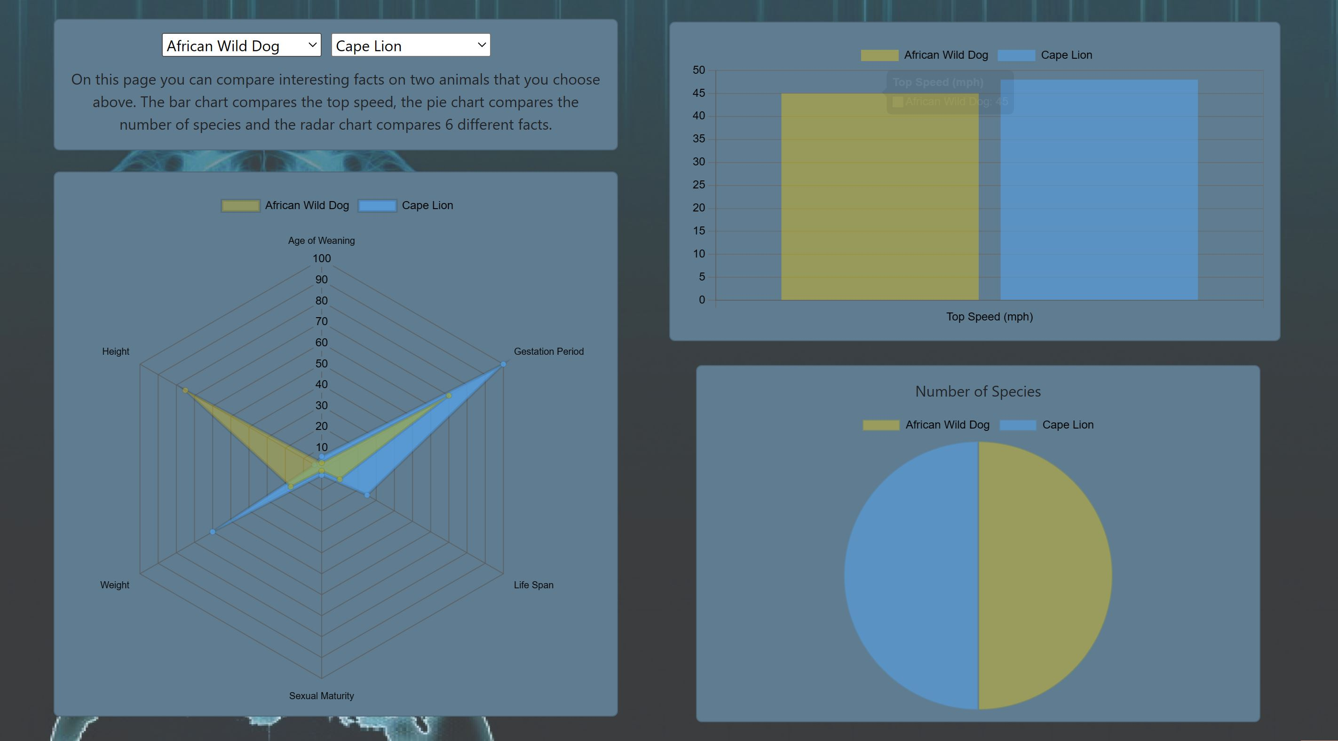
Feature and Functionality – Compare Page
The requirements for this page was that it needed to display three charts on this page, where data could be changed by a selection from a dropdown box. Based on the selection made three charts will be displayed as to compare two animals with. The Pie chart shows the number of species for the chosen animals. The Bar chart shows the top speed of the two animals chosen. The Radar chart shows the age of weaning, gestation period, life span, sexual maturity, height and weight of the chosen animals.

Slide 12
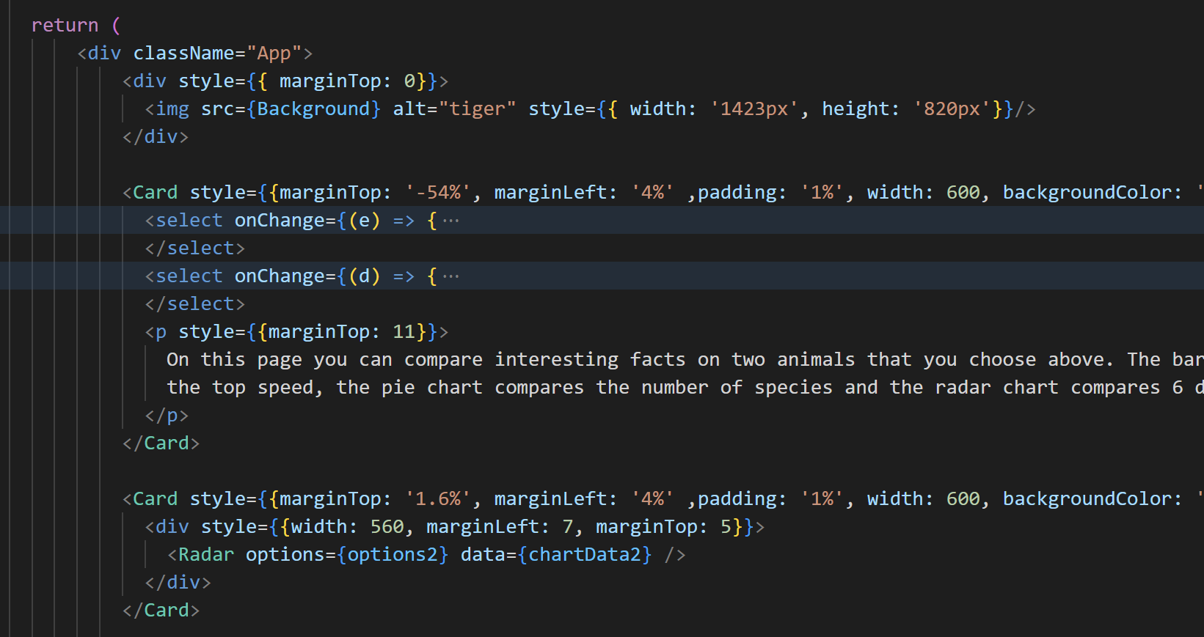
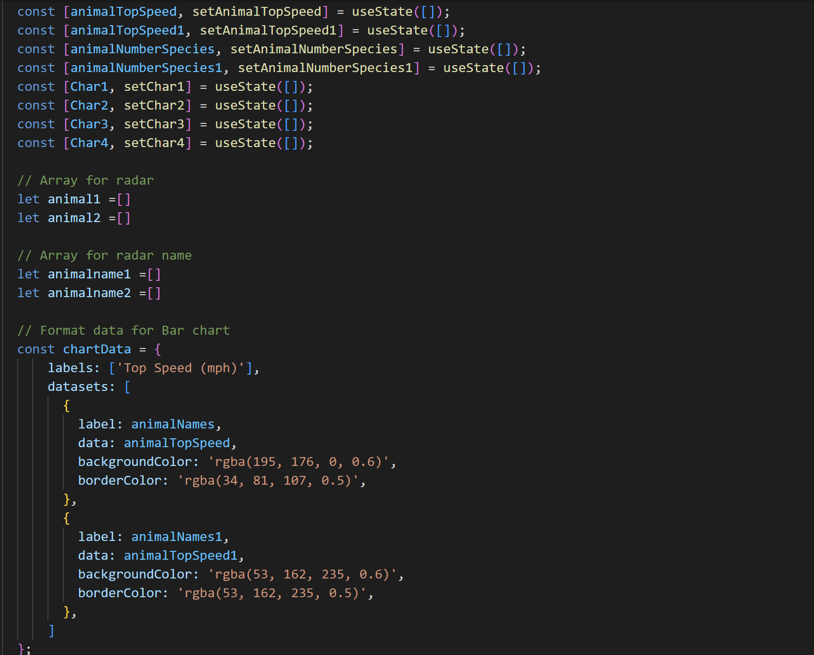
Code – Compare Page

Slide 13
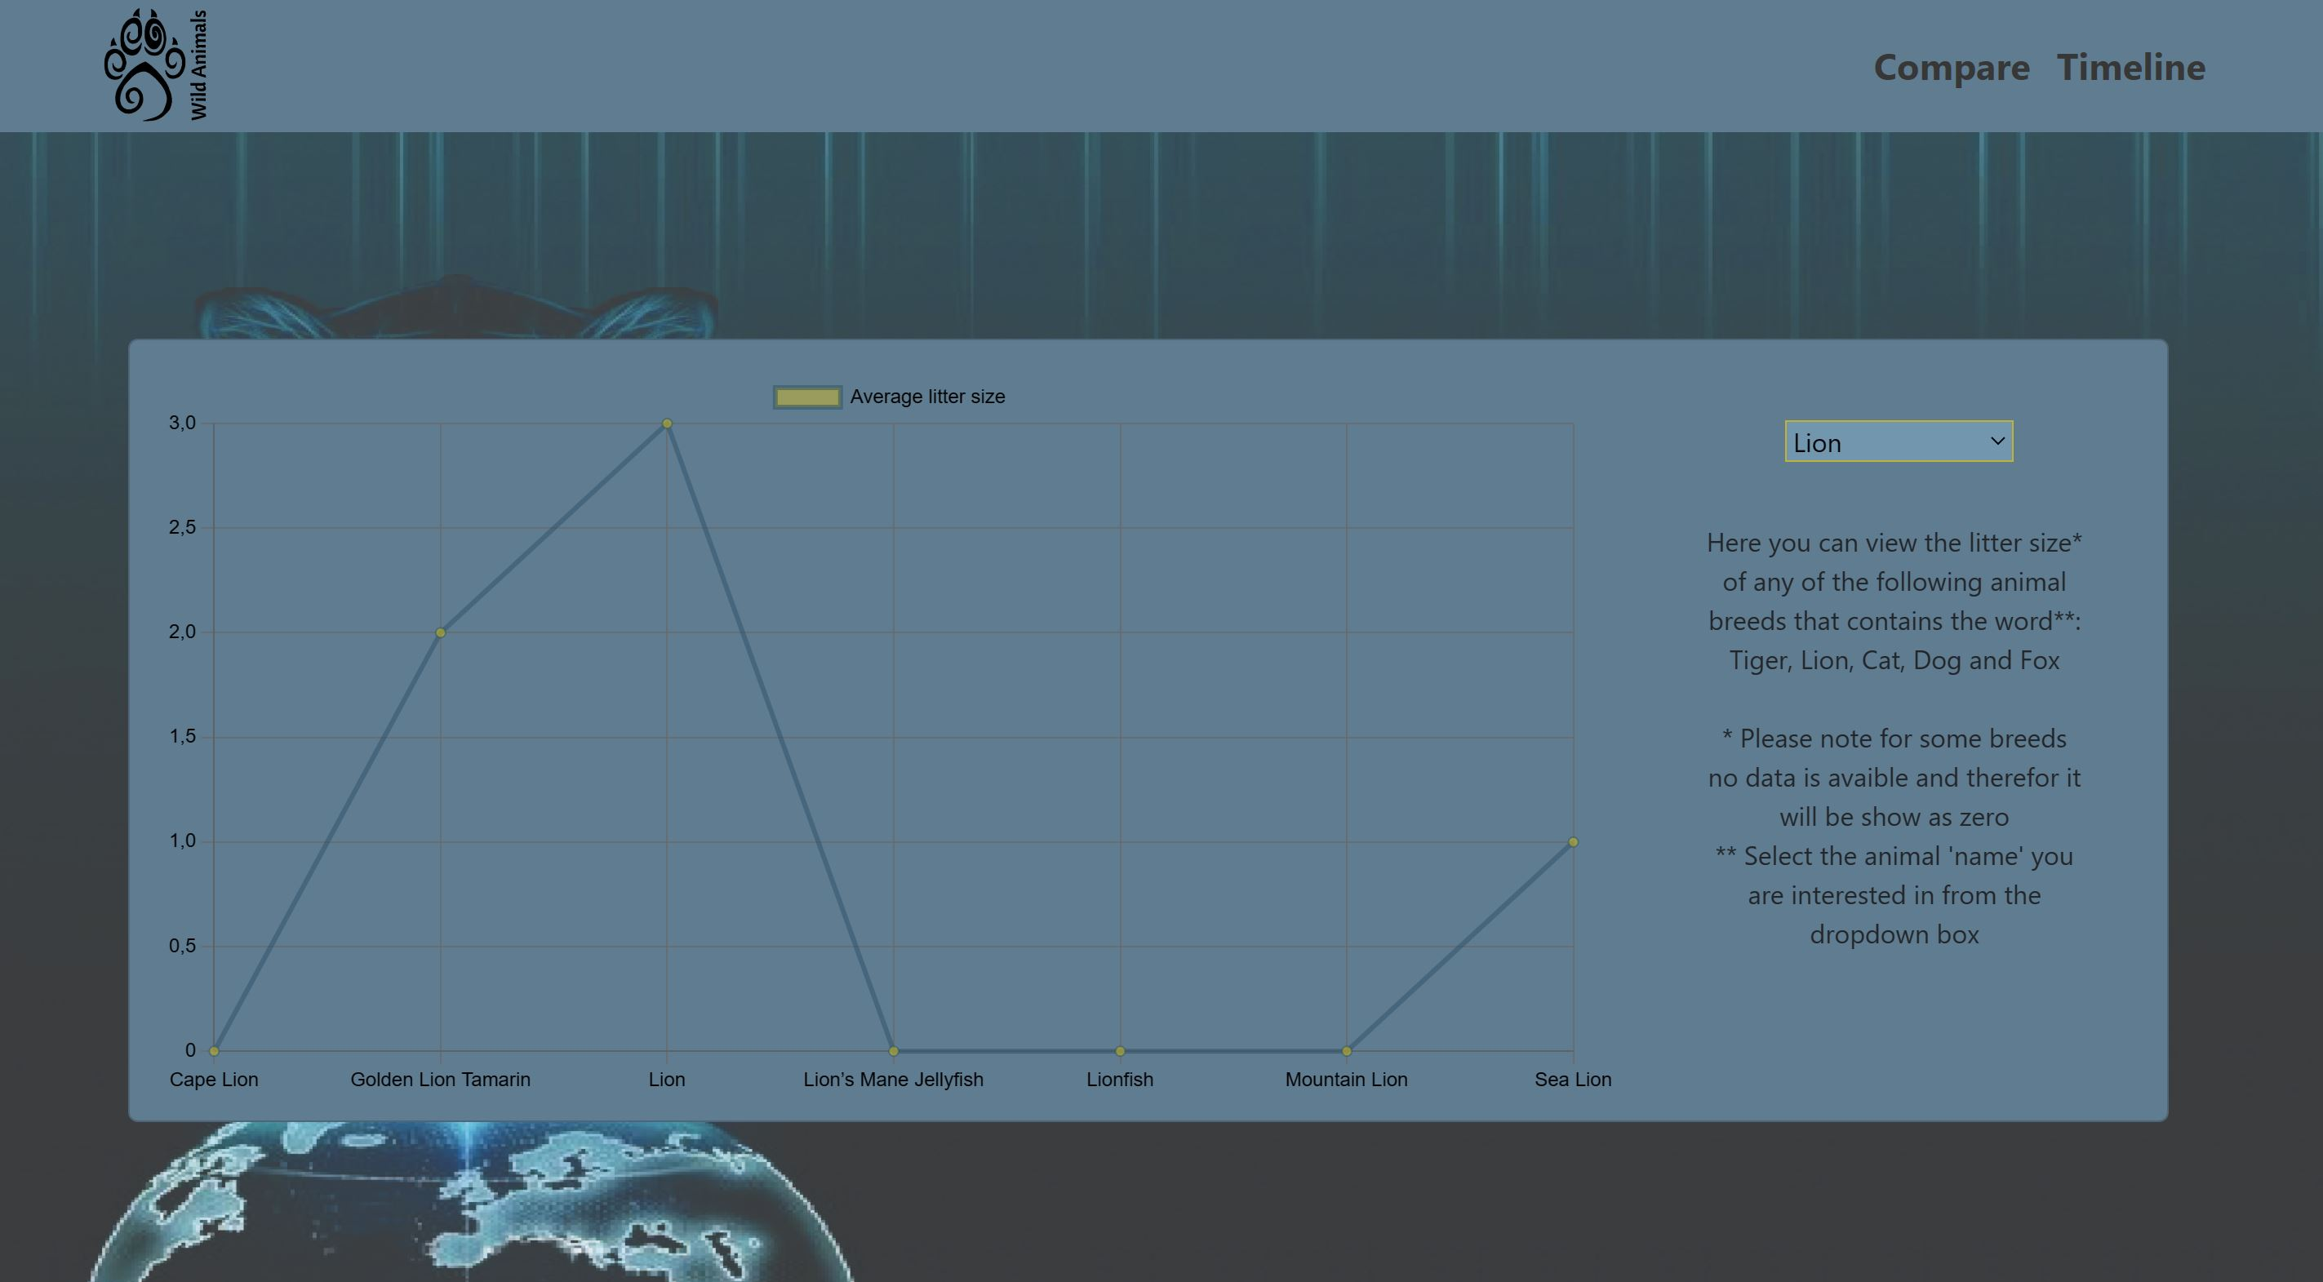
Feature and Functionality – Timeline Page
The requirements for this page was that it needed to display a timeline chart on this page where the data could be changed by a dropdown box. The timeline page shows the average litter size of the chosen animal on a timeline chart. Five different animals can be chosen.
*Please note my dataset did not had any date/time related information. I therefor used number related data for timeline page.

Slide 14
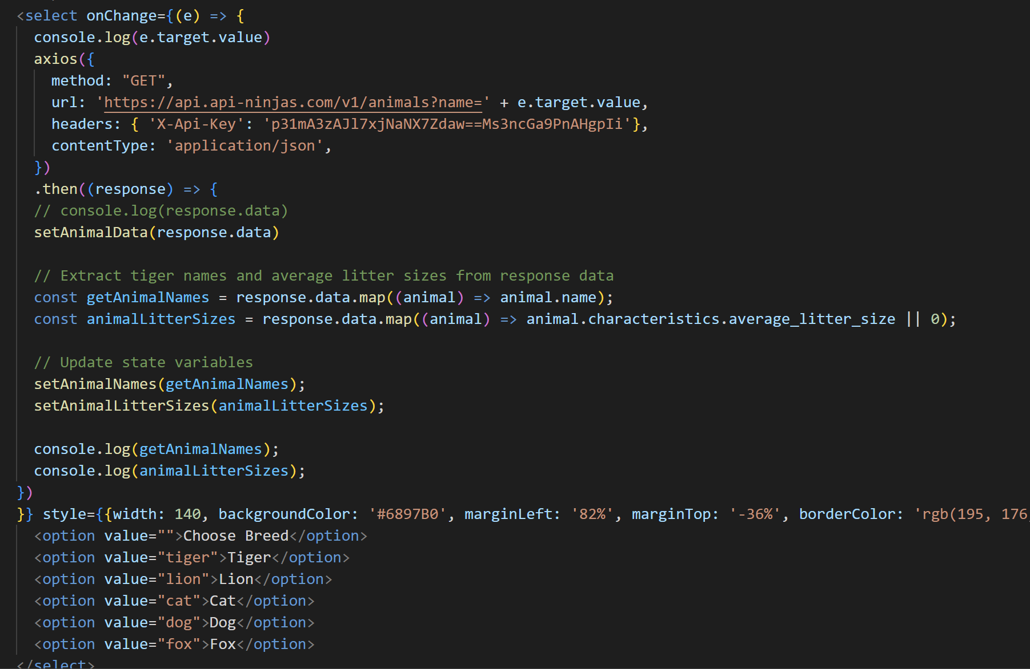
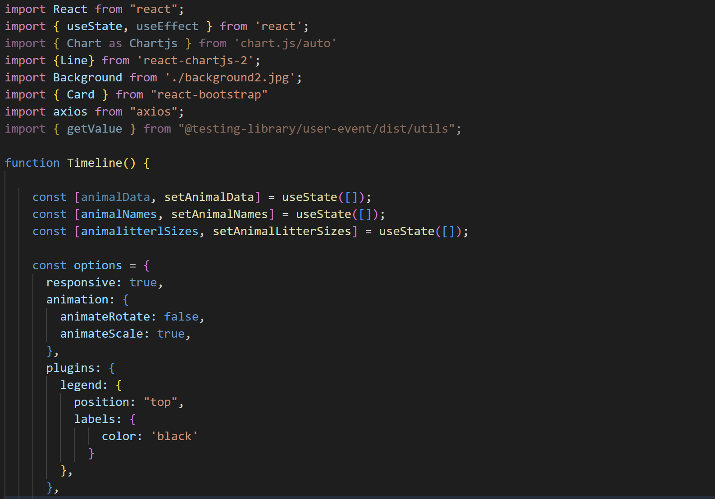
Code – Timeline Page

Slide 15
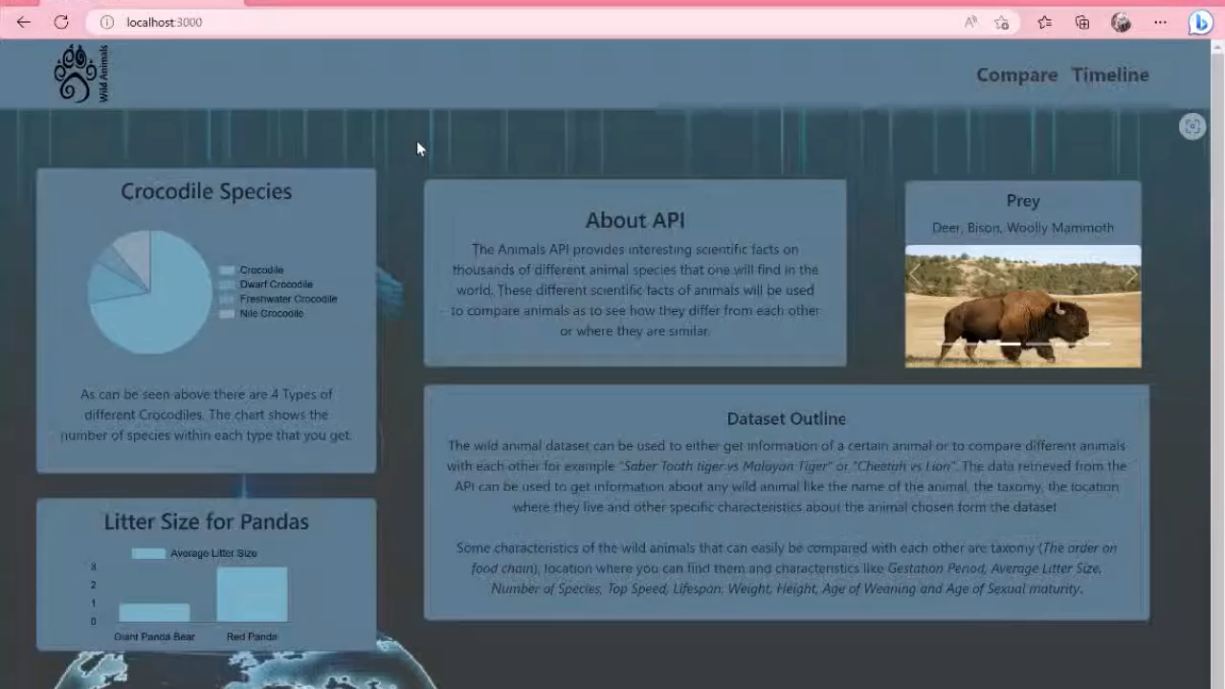
Final Output

Slide 16



Additional Learnings
Data analysis
I had to extract the data from the API and analyse it as to determine which of the many API attributes was best for me to use on the website
Manipulate data read from API into a chart friendly format
Some data like speed returned with text included i.e.
I had to use the split or slice as to get to numeric data to use in the graph
Redefining undefined data
For some animals data returned as ‘Undefined’, to plot the graphs I had to change this to zero
i.e.

Slide 17
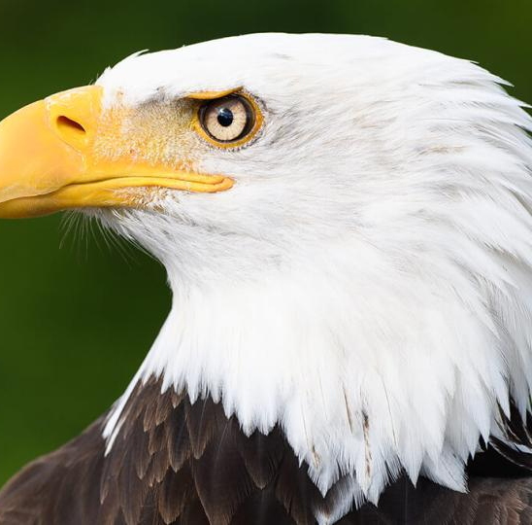
Conclusion
As can be seen in the demo the website created adhered to the project requirements as requested in the brief. My final website has many functional elements. The wireframes was used to ensure that the look and feel of the created website was done as expected, some screen elements was changed during the development process as I realized certain elements needed to be swapped for better readability. The project had its challenges that I struggled with while doing this project was to display my different characteristics of animals on the 4 charts we needed to have. I used React, Charts.js, JS, CSS and GitHub during the development process.

